Slide 1
TECHNICAL DESCRIPTIONS

Slide 2
Kinds of Technical Descriptions
Mechanism Descriptions: provide a detailed overview the physical aspects of a tool, machine or other mechanical device that has moving parts and is designed to perform a specific function. These could be product descriptions for sales or manufacturing, documentation of design specifications, info-graphics, etc.
Process Descriptions: detail a series of events (natural/biological/ecological, mechanical, social, or psychological phenomenon) that happen in a particular sequence in order to achieve a specific outcome.
Definitions: clarify the specific meaning, often related to a specific context, or express the essential nature of the terms being defined. These can range in length from a simple clarifying phrase to an extended document of several pages. Definitions will often include detailed descriptions and visuals to illustrate ideas.

Slide 3
Purpose
Descriptions provide a physical picture or functional view of an object. They help the reader understand WHAT the object is, what it does, how it works, and how it is made.
They are both visual and textual, relying on the 5 senses
Technical descriptions take many forms
Product descriptions for sales or manufacturing
Design specifications
Instruction manual
Info-graphic

Slide 4
Audience
How you describe a mechanism will depend on your purpose and your audience, AKA rhetorical situation
Imagine describing a solar panel, its purpose, its component parts and how they work together
To a 6-year old
To a 1st year university student in electrical engineering
To a technician who manufactures them

Slide 5
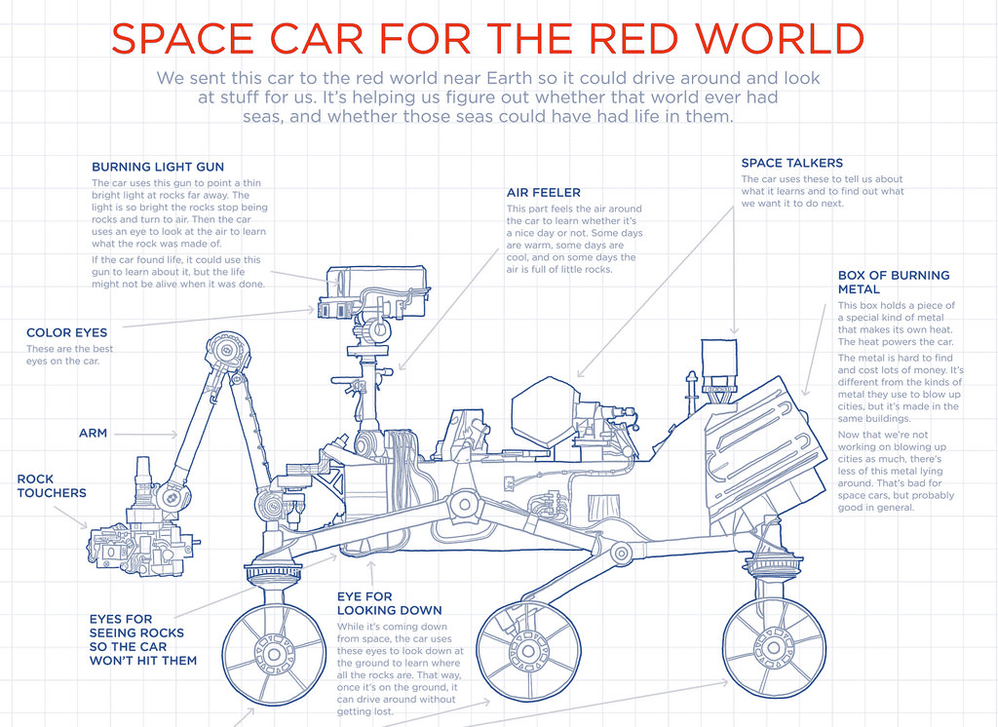

[1]
Notes:
[1] From Thing Explainer

Slide 6



Consider the knowledge level of your audience and put things in terms they will understand

Slide 7
How to write a Technical Description
Before you can plan your description, consider your rhetorical situation. Specifically, consider your
PURPOSE
AUDIENCE
Which kind of description is required

Slide 8
Mechanical Description
A mechanical description (that is the technical description of the object’s mechanics – this is not a process description or a definition) should provide a clear picture of the object and include descriptions of:
general appearance and physical properties
overall function and purpose
component parts
how the parts interact to make a functioning whole

Slide 9
Process – how to write a description
Definition: What is it, and what is its main purpose?
Overview: Describe the mechanism’s overall appearance (“big picture”).
Components: Describe the main component parts in labelled sections; consider the order of information carefully here. Create a logical connection between each component described.
Explanation: how do the parts work together to fulfil its function? What key principles govern its functioning? Consider how much detail is necessary here for your intended audience.
Visuals: include graphics that clearly illustrate the mechanism and/or its parts. Show the device as a whole; consider showing specific details in expanded views, cut-aways, or labelled diagrams. You may even embed or link to videos showing the device in action.
Conclusion: depending on the purpose, you might review product’s history, availability, manufacturing, costs, warnings, etc.)
References: Sources you have used in your description, or additional sources of information available (if relevant).

Slide 10
“Tycho Station, the Belt headquarters of the company, was a massive ring station built around a sphere half a kilometer across, with more than sixty-four million cubic meters of manufacturing and storage space inside. The two counter-rotating habitations rings that circled the sphere had enough space for fifteen thousand workers and their families. The top of the manufacturing sphere was festooned with half a dozen massive construction waldoes that looked like they could rip a heavy freighter in half. The bottom of the sphere had a bulbous projection fifty meters across, which housed a capital-ship-class fusion reactor and drive system, making Tycho Station the largest mobile construction platform in the solar system. Each compartment within the massive rings was built on a swivel system that allowed the chambers to reorient to thrust gravity when the rings stopped spinning and the station flew to its next work location.
Holden knew all this, and his first sight of the station still took his breath away. It wasn’t just the size of it. It was the idea that four generations of the smartest people in the solar system had been living and working here as they helped drag humanity into the outer planets almost through sheer force of will.”
From James S. A. Corey’s Leviathan Wakes p179-180.

Slide 11
Visuals
Depict entire mechanism and/or its components
Labelled diagram/computer graphic/photograph
Cut away image, blow up, etc.
Captioned and numbered

Slide 12
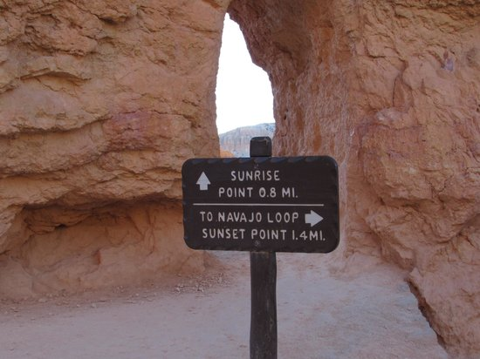
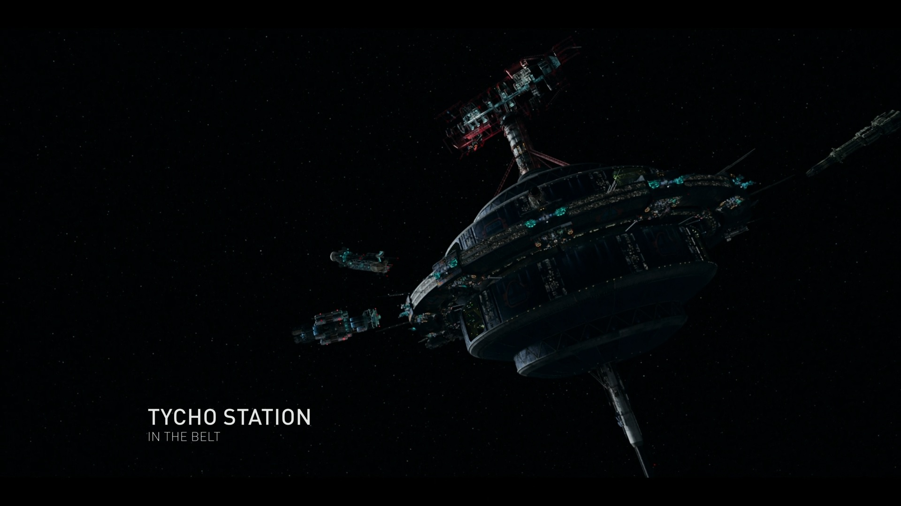
Flow of Description
Use a logical principle to organize your description
Top to bottom (or foundation upward)
Left to right (or right to left)
Inside to outside (or outside to inside)
Most important to least important features
Central component to peripherals
Material properties, etc.

Slide 13
Language
Use specific, precise, concrete terms – avoid vague or overly-general terms
Use correct terminology – define terms as necessary for your audience
Use analogy to describe an unfamiliar thing in terms of a familiar thing
Use objective language – no “ad speak” or subjective terms
Use present tense, active verbs to describe how the device appears and what it does
Use words that create vivid and specific pictures in the reader’s mind.

Slide 14

Practice – Describe this object
To a 6 year old
To a bike commuter

Slide 15
For further information
Please read TWE Chapter 7.4

Slide 16
References
[1] R. Munroe, Thing explainer, Houghton Mifflin Harcourt, 2015
[2] “Navajo trail photo: marker along queen’s trail,” Tripadvisor, http://www.tripadvisor.com/LocationPhotoDirectLink-g143015-d146418-i78331412-Navajo_Trail-Bryce_Canyon_National_Park_Utah.html, accessed Jan 20, 2016.
[3] “NASA mars rover,” Artist’s Concept of Rover on Mars, http://photojournal.jpl.nasa.gov/catalog/PIA04413, accessed Jan. 19, 2016

